Slide 1
CNS infections - 1
Chamila Mettananda
Senor lecturer and Consultant Physician

Slide 2
CNS infections

Slide 3
CNS infections
meningitis
encephalitis
cerebral abscess
cerebral malaria

Slide 4
Presentation

Slide 5
Presentation
fever
headache, vomiting
photophobia
alteration/ loss of consciousness
fits
alteration of mental state, behaviour, cognitive function
myalgia, arthralgia – (viral)

Slide 6
Examination

Slide 7
Examination
ABC
level of consciousness – GCS
fundi - papilloedema
neck stiffness, Kernig’s
focal signs
↑ ICP
rash – meningococcus
septicaemia – other organ functions
source of sepsis – ear infection, skull fractures, parameningeal, systemic

Slide 8
Meningitis
fever, headache, vomiting
photophobia
meningeal irritation
Encephalitis
altered consciousness
disorientation
behavioural changes
seizures
focal deficits
* Usually, a meningo-encephalitis

Slide 9
Investigations

Slide 10
Investigations
FBC, ESR, CRP, glucose, U & E, chest X-ray
Blood culture
MP
EEG
Lumbar puncture - CSF analysis
Viral serology
CT scan, MRI scan

Slide 11
CSF- normal values
Pressure:
Appearance:
CSF total protein:
CSF glucose:
Cells:

Slide 12
CSF- normal values
Pressure: 60-150 mm H₂0.
Appearance: clear, colorless.
CSF total protein: 0.2-0.4 g/L.
CSF glucose: 2/3 to ½ of blood glucose level
Cells <5/mm^{3,} mononuclear cells only

Slide 13
Investigations - CSF analysis
 | appearance | protein | cells | glucose
bacterial | turbid | ↑ | ↑ PMN (or L) | ↓ ↓
viral | clear | N or ↑ | ↑ L | N
TB | xanthochromic, coagulum | ↑ ↑ | ↑↑ L (or PMN) | ↓
fungal | turbid | ↑ ↑ | ↑ L | ↓

Slide 14
CSF analysis - microbiology
bacterial - Gram stain, culture, antigens , PCR
TB - AFB, PCR, culture
viral - PCR - HSV, JE, entero
fungal - India ink staining, culture

Slide 15
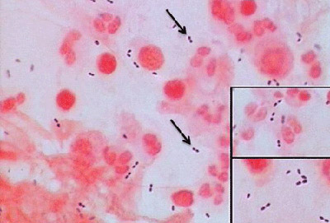
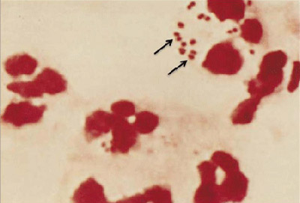
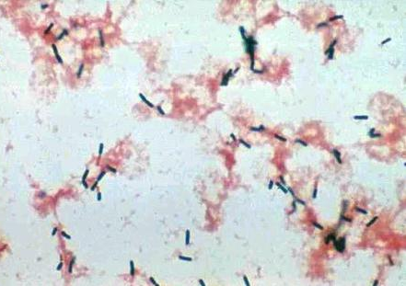
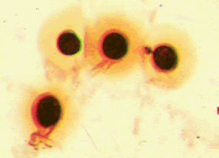
CSF microscopy

Slide 16
CSF microscopy
Streptococcus pneumoniae
Neisseria meningitidis
Listeria meningitidis
Cryptococcus neoformans

Slide 17
When to do CT before LP?
focal neurological signs
loss of consciousness
signs of raised ICP - papilloedema
seizures
elderly
immuno-compromised

Slide 18
CNS infections -2

Slide 19
CNS infections
meningitis
encephalitis
cerebral abscess
cerebral malaria

Slide 20
Causes
Infectious -
  Bacterial –
    Streptococcus pneumoniae
    Neisseria meningitidis
    Listeria monocytogenes – old age, immune deficient
    H. influenzae
    Mycobacterium tuberculosis
  Viral –
    Enteroviruses – ECHO, Coxsackie
    Mumps,
    HSV-2, CMV, EBV, VZV
    HIV
  Fungal – Cryptococcus neoformans
  Spirochaetal – syphilis, leptospira
Non-infectious - malignant, chemical, drugs

Slide 21
Pathophysiology
bacterial growth / lysis in subarachnoid space
release of bacterial products
acute inflammatory response - mediators
↑ vascular permeability
cytotoxicity, endothelial cell injury
obstruction to CSF flow
cerebral oedema
↑ ICP
neuronal death, coning

Slide 22
Management

Slide 23
Management
emergency - cannot wait for lab reports
blood culture x 2-3
empiric antibiotics iv -
  ceftriaxone/ cefotaxime ± vancomycin OR
  penicillin + chloramphenicol
  add ampicillin - old age, immuno-compromised
iv dexamethasone -
  0.15 mg/kg 6h for 4d (adults -usu 8mg 6h)
  given before or with the first antibiotic dose
lumbar puncture

Slide 24
Complications

Slide 25
Complications
Local
↑ ICP
abscess
cranial n. palsies- VI, VIII
seizures
hydrocephalus
subdural empyema
venous thrombosis
arteritis - infarcts
Systemic
septicaemia
DIC
Hyponatraemia, SIADH
adrenal crisis
endocarditis

Slide 26
TB Meningitis

Slide 27
TB Meningitis
acute/ subacute onset
prodromal illness - vague ill health, LOA, LOW, low grade fever, behavioural change
evidence of TB elsewhere – only in ~ 30%
choroidal tubercles on retina
tuberculoma – act as focal lesion
TB arteritis – infarcts, rarely haemorrhages
treatment – anti-TB Rx for 6-9 months

Slide 28
CNS infections
  Meningitis
  Encephalitis
  cerebral abscess
  cerebral malaria

Slide 29
  Encephalitis
Infectious – Viral
Autoimmune
  antibody mediated
  some - paraneoplastic

Slide 30
Viral encephalitis
Arboviral -JE
Herpes simplex - HSV - type I
VZV, EBV, CMV
Mumps
Rabies

Slide 31
Presentation
fever
headache, vomiting
alteration/ loss of consciousness
fits
alteration of mental state, behaviour, cognitive function
meningeal irritation - ?
focal deficits
extrapyramidal features - esp JE
ataxia - cerebellitis in VZV

Slide 32
suggest viral -
myalgia, arthralgia
rash
lymphadenopathy
hepatosplenomegaly
parotid enlargement

Slide 33
HSV encephalitis
mainly type 1
temporal and inferior frontal lobes predominantly affected - - seen on EEG, MRI
CSF - viral pattern + RBC PCR
treatment - iv acyclovir - 14-21 days

Slide 34
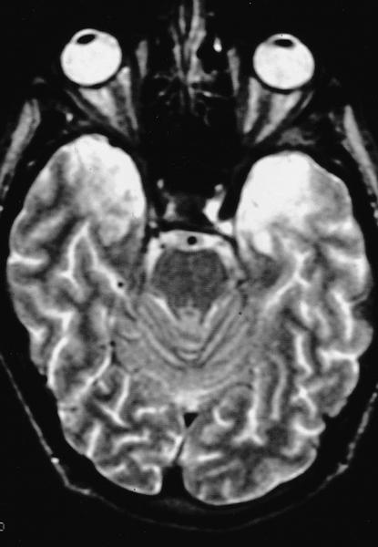

Slide 35
CNS infections
  meningitis
  encephalitis
  cerebral abscess
  cerebral malaria

Slide 36
Brain abscess - pathogenesis

Slide 37
Brain abscess - pathogenesis
local spread - contiguous suppurative foci
  otitis media, sinusitis, mastoiditis, dental sepsis
haematogenous spread - distant septic focus
penetrating head injury, neurosurgery
20% - no apparent source

Slide 38
common organisms
  staphylococci - S. aureus, coagulase -ve, MRSA
  streptococci - pneumo, S. viridans
  anaerobes
  Gram negative
  pseudomonas
polymicrobial infection common

Slide 39
Presentation

Slide 40
Presentation
acts as a space occupying lesion
  focal deficits
  seizures
  ↑ ICP - headache, vomiting, papilloedema
  altered consciousness
subacute onset
fever - low grade
meningeal irritation - mild

Slide 41
Diagnosis
imaging - MRI, CT - negative early
EEG
microbiology -
  blood culture
  aspirate from abscess
look for primary source
avoid LP - if abscess suspected

Slide 42
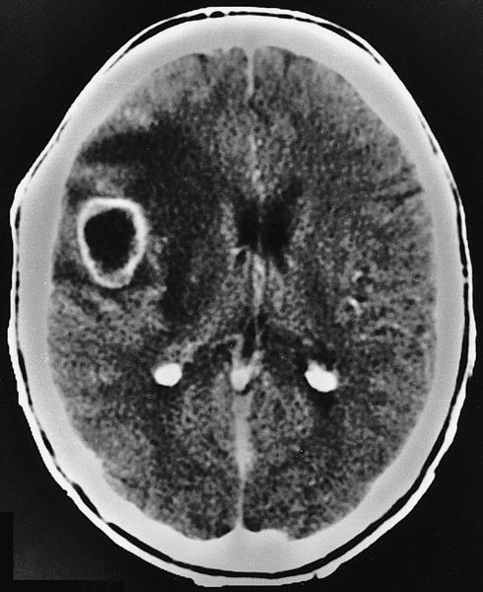

Slide 43
Treatment
iv antibiotics - start empiric treatment continue for 6-8 weeks
  cephalosporin OR penicillin/ chloramphenicol
  + metronidazole
  ± vancomycin
surgery
supportive care - iv dexamethasone, seizures
treat primary focus

